Slide 1
Data Science Training Regularization
Oct 19th 2016

Slide 2
Machine Learning
Today we extend the linear framework and look at regularisation.
How to avoid a model over fitting on too many variables for,
Prediction accuracy
Model Interpretability (which predictors drive a response)
See the book on Box or free online An Introduction to Statistical Learning, with Applications in R. Gareth James, Daniela Witten, Trevor Hastie and Robert Tibshirani

Slide 3
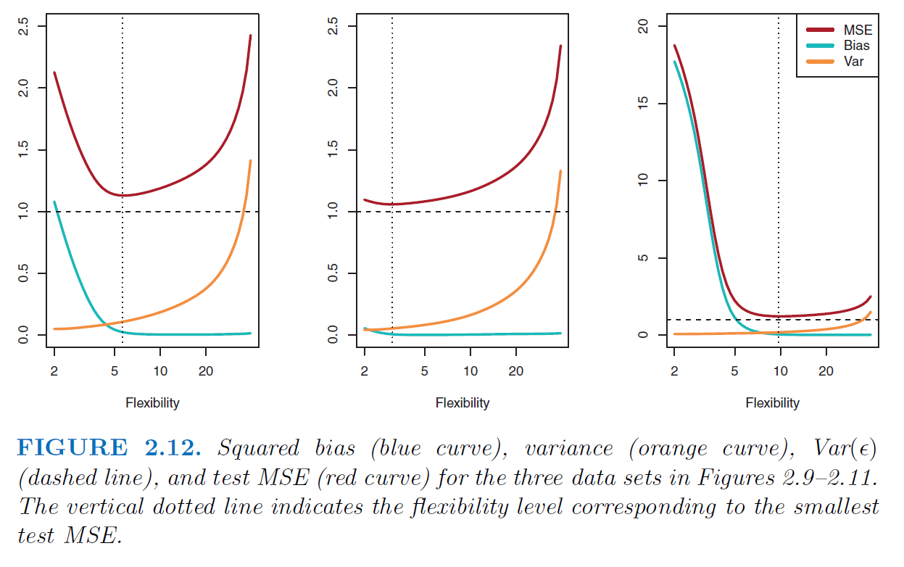
Bias Variance Trade off
Mean Sq. Error
Bias to few predictors
Variance of model results

Slide 4
Subset Selection
Measurement
Model performance can be taken based on the F-score or cross validated score.
Forward Selection
Run a model on each single variable and measure, and keep the best variable.
Incrementally add one more variable at a time and measure. Keep the second best variable.
Keep iterating until the measure no longer improves.
Backward Selection
Run a model on all variables and measure.
Takeaway one variable at a time and measure. Remove permanently the variable giving the worst measurement.
Keep iterating until the measure no longer improves.

Slide 5
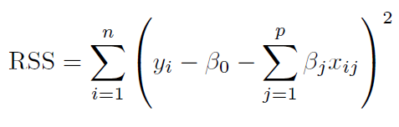
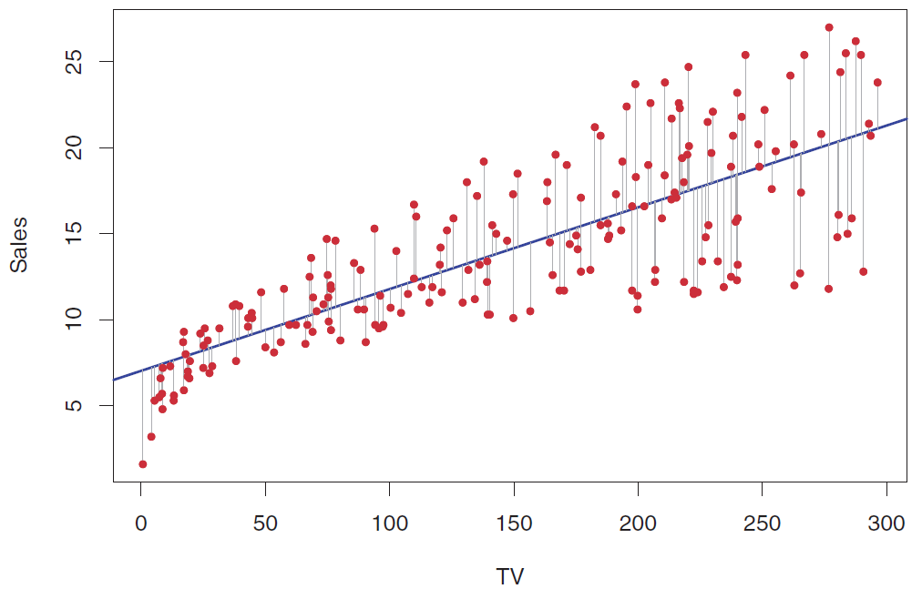
Linear Regression
Line
Residuals
Residual Sum of Squares,

Slide 6
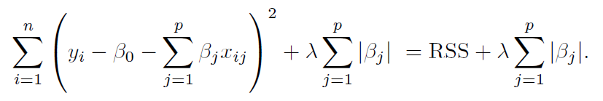
Shrinkage
Line
Residuals
Residual Sum of Squares,
Shrinkage term to consider number of variables in the model.

Slide 7
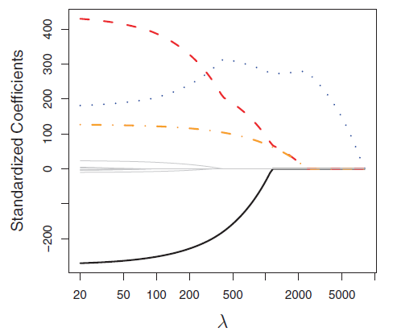
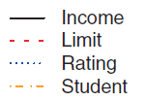
Shrinkage – Lasso Regression
Shrinkage term to consider number of variables in the model.

Slide 8
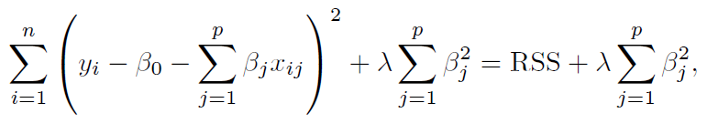
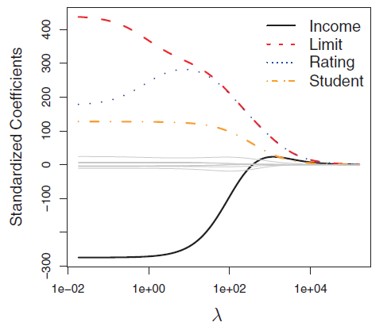
Shrinkage – Ridge Regression
Shrinkage term to consider number of variables in the model.

Slide 9
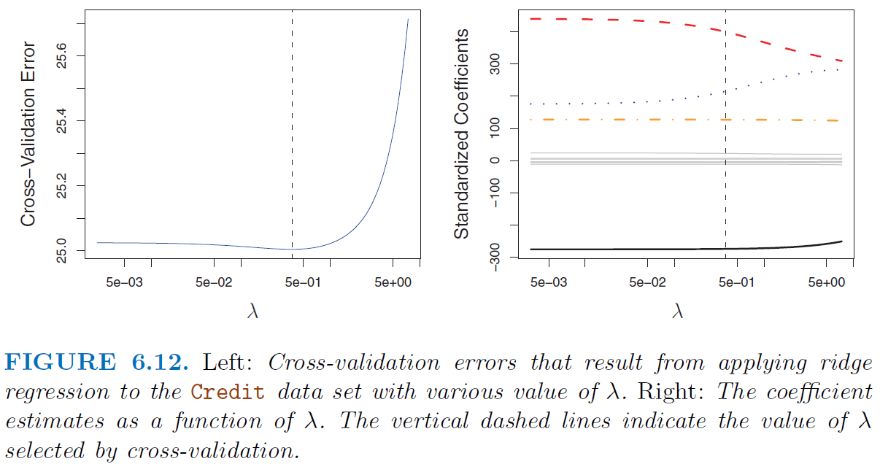
Selecting Regularisation Parameter

Slide 10
Thank you!

